Slide 1
BRITISH AIRWAYS PREDICTING CUSTOMER BUYING BEHAVIOUR
AMADI DOMINIC UCHECHI
5/16/2024

Slide 2
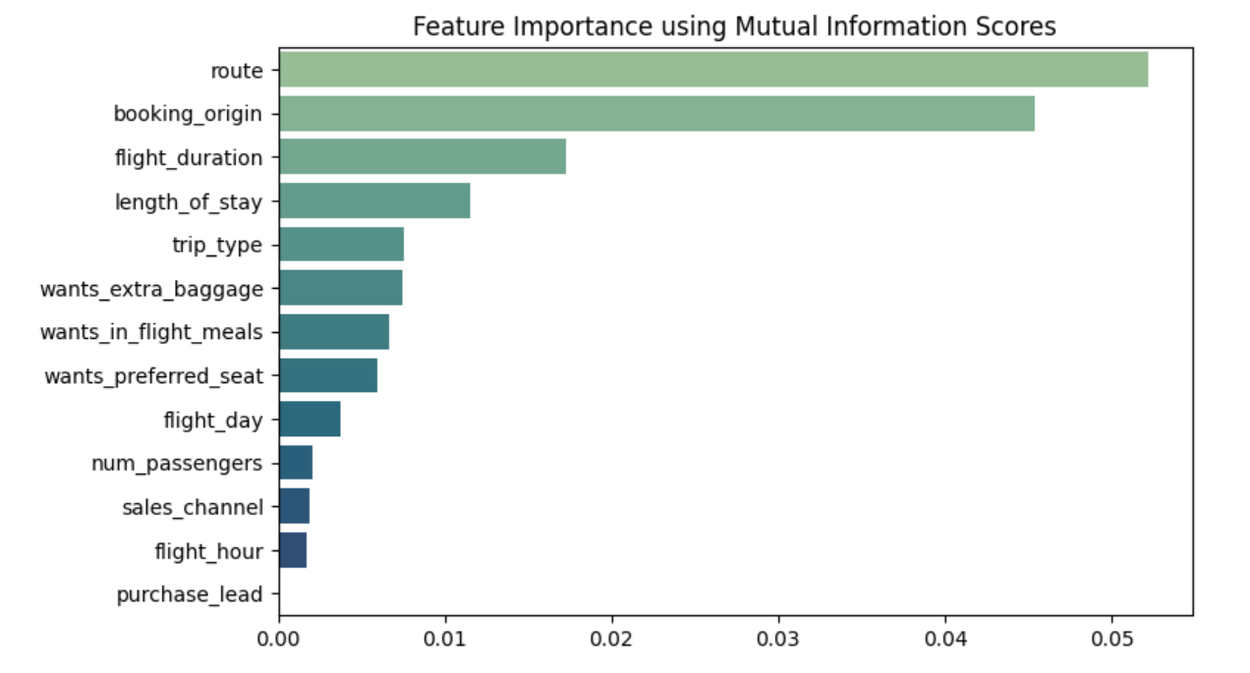
The dataset has been trained with Random Forest Classifier model Training Accuracy: 99.8% Validation Accuraccy: 85.17%
Top 5 features that influence customers buying behavious are:
route
booking_origin
flight_duration
length_of_stay
trip_typ
wants_extre_baggage

